Slide 1

Data Cube: A Relational Aggregation Operator Generalizing Group-By, Cross-Tab, and Sub-Totals
Presented by: Group - 04

Slide 2
Group Members
Md. Aquib Azmain – 0718
Rashiduzzaman Khan Rashed – 0719
Satyaki Das – 0720
S.M. Shakhawat Hossain – 0721
Abu Rafe Md. Jamil - 0722

Slide 3
Presentation Outline
Introduction
Problems with GROUP BY
CUBE and ROLLUP operators
Addressing the data cube
Computing cubes and roll-ups

Slide 4
Typical OLAP Operations
Roll up (drill-up): summarize data
by climbing up hierarchy or by dimension reduction
Drill down (roll down): reverse of roll-up
from higher level summary to lower level summary or detailed data, or introducing new dimensions
Slice and dice:
project and select
Pivot (rotate):
reorient the cube, visualization, 3D to series of 2D planes.
Other operations
drill across: involving (across) more than one fact table
…

Slide 5
DATA CUBES
Data cube is a structure that enable OLAP to achieves the multidimensional functionality.
The data cube is used to represent data along some measure of interest.
Data Cubes are an easy way to look at the data ( allow us to look at complex data in a simple format).
Although called a "cube", it can be 2-dimensional, 3-dimensional, or higher-dimensional.

Slide 6
DATA CUBES
databases design s is for OLTP and efficiency in data storage.
data cube design is for efficiency in data retrieval (ensures report optimization).
The cube is comparable to a table in a relational database.

Slide 7
Dimensions And Measures
data cubes have categories of data called dimensions and measures.
measure
represents some fact (or number) such as cost or units of service.
dimension
represents descriptive categories of data such as time or location.

Slide 8
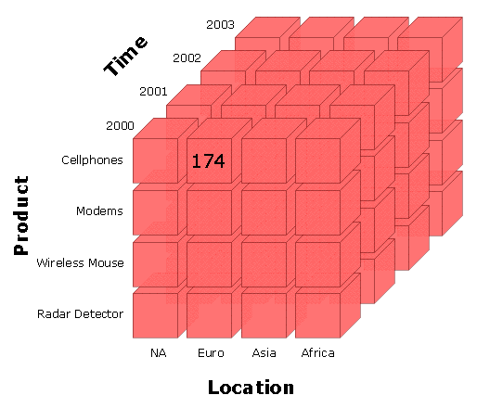
Dimensions And Measures

Slide 9
Data Cubes Concepts
Three important concepts associated with data cubes :
Slicing.
Dicing.
Rotating.

Slide 10
Slicing
the term slice most often refers to a two- dimensional page selected from the cube.
subset of a multidimensional array corresponding to a single value for one or more members of the dimensions not in the subset.

Slide 11
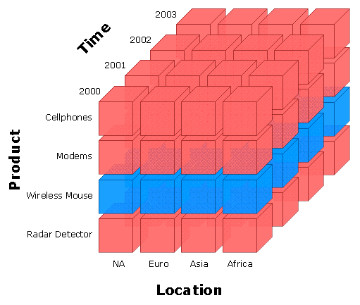
Slicing
Slicing-Wireless Mouse

Slide 12
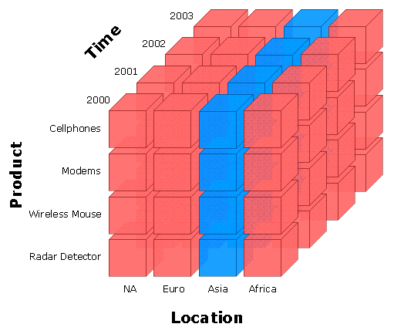
Slicing
Slicing-Asia

Slide 13
Dicing
A related operation to slicing .
in the case of dicing, we define a subcube of the original space.
Dicing provides you the smallest available slice.

Slide 14
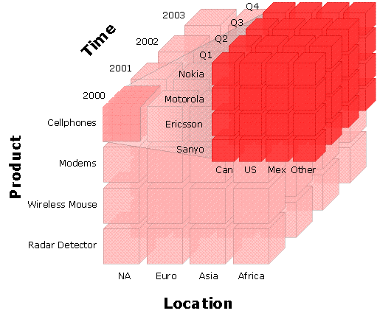
Dicing

Slide 15
Rotating
Some times called pivoting.
Rotating changes the dimensional orientation of the report from the cube data.
For example …
rotating may consist of swapping the rows and columns, or moving one of the row dimensions into the column dimension
or swapping an off-spreadsheet dimension with one of the dimensions in the page display

Slide 16
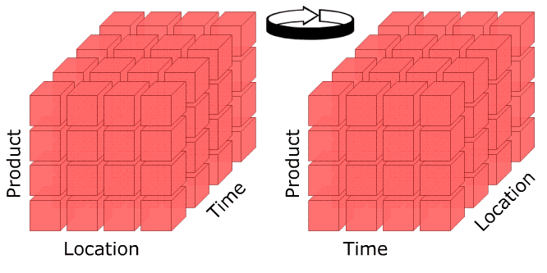
Rotating

Slide 17
Dimensions
represents descriptive categories of data such as time or location.
Each dimension includes different levels of categories.

Slide 18
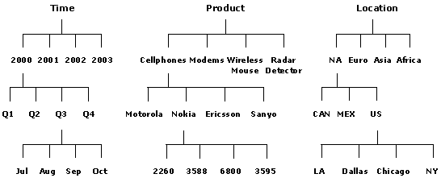
Dimensions

Slide 19
Categories
is an item that matches a specific description or classification such as years in a time dimension.
Categories can be at different levels of information within a dimension.

Slide 20
Categories
parent category
is the next higher level of another category in a drill-up path.
child category
is the next lower level category in a drill-down path.

Slide 21
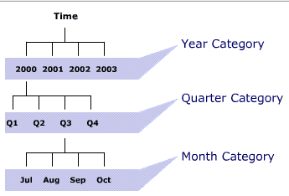
Categories

Slide 22
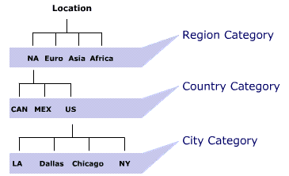
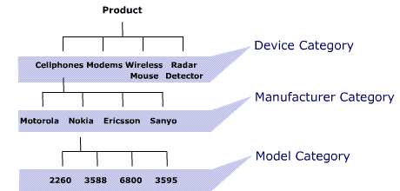
Categories

Slide 23
measures
The measures are the actual data values that occupy the cells as defined by the dimensions selected.
Measures include facts or variables typically stored as numerical fields.

Slide 24
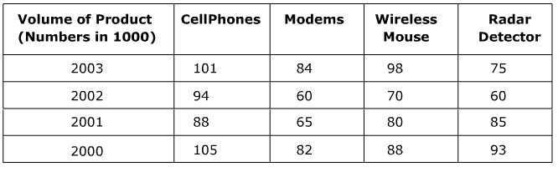
measures

Slide 25
Computed versus Stored Data Cubes
The goal is to retrieve the information from the data cube in the most efficient way possible.
Three possible solutions are:
Pre-compute all cells in the cube.
Pre-compute no cells.
Pre-compute some of the cells.

Slide 26
Computed versus Stored Data Cubes
If the whole cube is pre-computed
Advantage
the queries run on the cube will be very fast.
Disadvantage
pre-computed cube requires a lot of memory.

Slide 27
Computed versus Stored Data Cubes
To minimize memory requirements, we can pre-compute none of the cells in the cube.
But the queries on the cube will run more slowly.
As a compromise between these two, we can pre-compute only those cells in the cube which will most likely be used for decision support queries.

Slide 28
representation of Totals
A simple data cube does not contain totals.
The storage of totals increases the size of the data cube but can also decrease the time to make total-based queries.
A simple way to represent totals is to add an additional layer on n sides of the n-dimensional data cube.

Slide 29
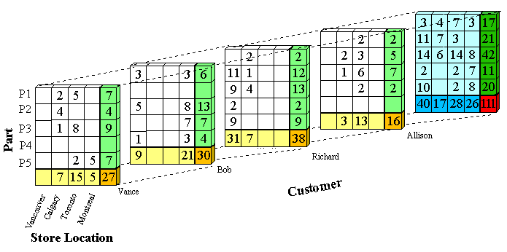
representation of Totals

Slide 30
REFRENCES
http://training.inet.com
Data Mining Concepts and techniques , 2E.
to NASA’s Data Cube Training presentation .
http://projects.cs.dal.ca/panda/datacube.html

Slide 31
The end

